Slide 1
Data
Introduction to Unix for HPC

Slide 2
Unit 1: Making a move (using FTP)
Goals:
Can login via Secure FTP and see home directory.
Can transfer a file from local machine via FTP to home directory.
Understands the difference between DOS and UNIX formats.
Can convert files between DOS and UNIX formats.
Can transfer a file created on the server back to local machine.

Slide 3
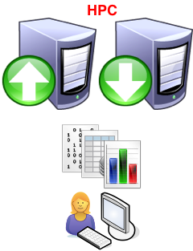
The Problem
We can interact with the command line over SSH.
We can create directories (folders), move between them.
We can create files and move them around, delete them, etc.
We can run a program and get some output.
But how can we
Upload files, say our datasets, to the HPC machine?
Download files, say the results of our analysis, from the HPC machine for further analysis locally?

Slide 4
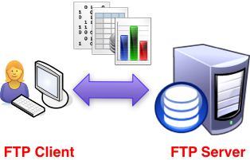
The Solution
Well there are two to choose from:
FTP = File Transfer Protocol
SCP = Secure Copy (covered later)
Let’s start with FTP

Slide 5

Connecting to an FTP Server
The HPC training machine runs an FTP server.
To connect to it you need an FTP client, such as FileZilla.
You tell the client which server to connect to:
octane.intersect.org.au
Port: 22
You authenticate with your username and password.
All FTP communication to the HPC machine is secure.

Slide 6
Exercise 1(a) Connecting to the training HPC machine

Slide 7
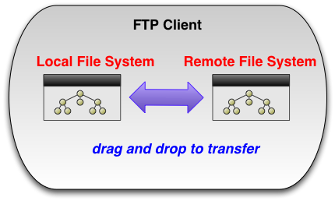
Transferring Files
In the exercise to follow, we’ll stick to using FileZilla, but most graphical FTP programs follow this analogy:

Slide 8
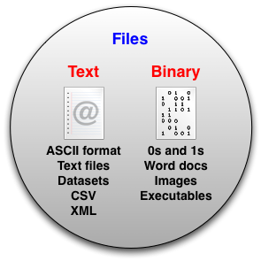
Text Files vs Binary Files

Slide 9
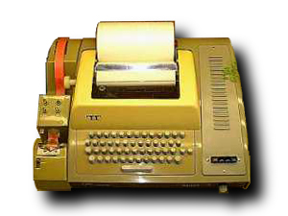
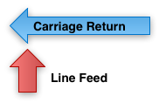
Text Files
Text files contain special non-printing characters to signify new lines.
Some systems use two characters:
Carriage Return (CR)
Line Feed (LF)
Others use just one:
Line Feed (LF)
Teletype Machine

Slide 10
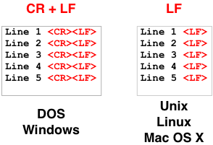
Because the training HPC machine is a Linux machine and our local machines run Windows, we need to convert our text files.

Slide 11
Exercise 1(b) Creating and Transferring files
Command | Description
file <file> | Determines the file type of <file>
dos2unix <file> | Converts files from DOS/MAC to UNIX text file format
recode <file> | Converts files between various character sets and surfaces, e.g. from UNIX to DOS
recode latin1..dos <file> | Converts file <file> to DOS format

Slide 12
Unit 2: The Second Date (using SCP)
Goals:
Can use pscp to upload multiple files at once.
Can use pscp to download multiple files at once.

Slide 13
SCP and PSCP
Secure Copy (scp) is another way to transfer files to and from the HPC machine.
Like SFTP, it is secure.
Unlike SFTP, we’ll be invoking it from the Windows command line
SCP is non-interactive and, therefore, it can be scripted.

Slide 14

SCP vs SFTP
SCP does the same task as SFTP.
Use which- ever tool you feel more comfortable with.

Slide 15
PSCP – An SCP Client
Putty comes with an SCP client pscp.exe – Putty Secure Copy.
We’ll be using PSCP in the exercises.
To use it we need to open a Windows Command Prompt.
An easy way to do this is to select Run… from the Start menu and type cmd. Then click OK.

Slide 16
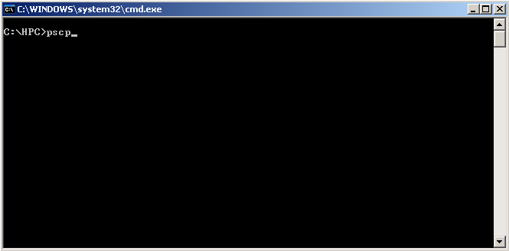
Windows command prompt

Slide 17
PSCP Syntax
Transfer file from local machine to the HPC machine:
pscp <file_name.ext> <user_name>@octane.intersect.org.au:<dest_dir>
The local file you want to copy
Your training account user name
Where you want the file to go on the HPC
machine

Slide 18
Exercise 2(a) Transferring files from your local machine to the training HPC machine using PSCP
Command | Description
echo %PATH% | DOS command to show the value for the PATH variable
set PATH=<path> | DOS command to set the value for the PATH variable equal to <path>
cd <directory> | DOS command to change the directory to <directory>

Slide 19
PSCP Syntax
Transfer file from the HPC machine to your local machine:
pscp <user_name>@octane.intersect.org.au:<path/to/file_name.txt> .
Where to put the file locally. In this case “.” for the current working directory
The path on the HPC machine to the file you want to copy
Your training account user name

Slide 20
Exercise 2(b) Transferring files from the training HPC machine to your local machine using PSCP
Command | Description
mkdir <directory> | DOS command to create a directory called <directory>

Slide 21
Unit 3: (W)get it on! Using Wget
Goals:
Can use the basic wget syntax to download a dataset from the web.

Slide 22

The Problem
We want to use a dataset that’s available on the web.
How do we get it on to the HPC machine?
By way of example, let’s use a dataset about public toilet locations!
It’s available here:
http://data.gov.au/dataset/national-public-toilet-map/

Slide 23
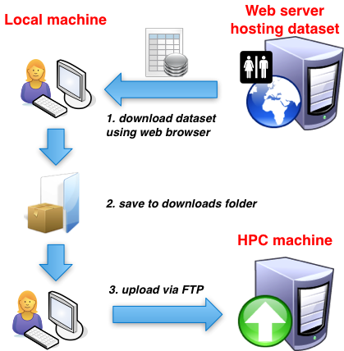
We could, of course, do this:
Entirely legitimate, just a bit involved

Slide 24
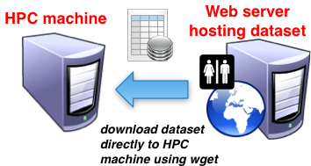
But this is better
Download the file directly from the web server to the HPC machine

Slide 25
To do this:
We need to be at the command line (i.e. logged into the HPC machine by SSH)
Type:
wget <URL_to_file>
For example:
wget http://raw.data.gov.au/610/Toiletmap.zip
This will download the dataset to your current working directory

Slide 26
Unzip it!
You’ll notice that this file has a zip extension.
This signifies that the file actually contains one or more files bundled for convenience and then (sometimes) compressed. It’s called an archive.
Other common archive formats have extensions tar, tgz, gz, bz2.
It sounds confusing, but try these simple recipes…

Slide 27
Recipes
File Extension | Command to unzip
.zip | unzip <file_name>.zip
.tar | tar xvf <file_name>.tar
.tgz | tar xzvf <file_name>.tgz
.gz | gunzip <file_name>.gz
.bz2 | bunzip2 <file_name>.bz2
If the file ends with an extension in the left column, use the corresponding command in the right column.

Slide 28
Exercise 3(a) Downloading and unzipping a dataset
Command | Description
wget <URL> | WGET will download the file stored at the location <URL>
unzip <file.zip> | Will unzip (unpack) the file <file.zip> into the current location
du <file> | The du command will show the disk space being used by file <file>
du -h <file> | The -h parameter to the du command will print the file size in human readable format (e.g., 1K 234M 2G)
du -s <file> | The -s parameter to the du command will display only a total for each argument

Slide 29
Unit 4: Things need to change, and quick! (Editing files in place)
Goals:
Can edit a file, save changes, and exit editor.

Slide 30
The Problem
We want to make a quick change to a
Dataset
Script

Slide 31
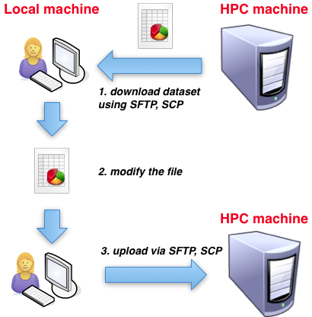
We could, of course, do this:
But it can get
cumbersome…

Slide 32
Instead we can edit in-situ using Nano
Invoke with:
Use the arrow keys to navigate your document
Update the text by typing, backspace, etc.
Use Control+O to save the file (^O).
Use Control+X to quit (^X).
nano <file_name.txt>

Slide 33
Exercise 4(a) Editing a file in-situ
Command | Description
nano <file> | Will open file <file> in a text file editor
CTRL+O | Using CTRL+O within the nano editor will cause any changes made to the file while editing to be saved to the file
CTRL+X | Using CTRL+X within the nano editor will cause the editor to close. If you have not already saved your changes you will be asked if you wish to save those changes by answering Y or N

Slide 34

A word of caution
As a matter of process it might be better to avoid editing in-situ on the HPC machine.
There is a good chance your scripts and datasets will get out of sync with your local copies.
This could generate confusion.
Generally better to have a single point of truth.

Slide 35
Unit 5: What’s mine is yours (Permissions and Ownership)
Goals:
Can make a file private.
Can allow another to read and write to a file.
Can make a script executable.

Slide 36

Security
Security is baked right into Unix
All files and directories have security attributes
Access can be limited by Read, Write, and Execute permissions
Based on Owner – Group – World model:

Slide 37
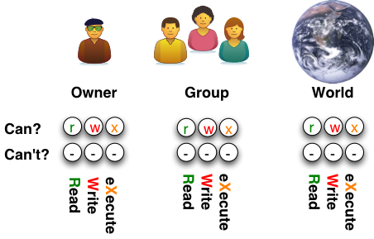
For every file and directory:

Slide 38
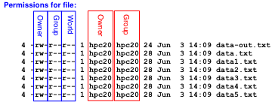
Checking file permissions
ls –ls reveals all:
It may come as a surprise, but by default the text files
I created are “world readable”!

Slide 39
Handy commands
Change Owner (chown)
chown <new_owner> <file_name>
Change Group (chgrp)
chgrp <new_group> <file_name>
Change Mode (chmod)
chmod <new_mode> <file_name>
We’ll concentrate on the last one.

Slide 40
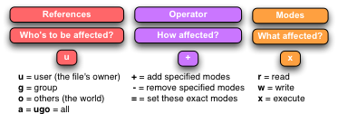
Chmod <new_mode> format:
chmod <new_mode> <file_name>

Slide 41
Chmod Recipes
Command | Result
chmod o-rwx <file_name> | Forbid others (the world) to read, write and execute.
chmod u+rwx,g-rwx,o-rwx <file_name> | Grant owner full permissions; deny all others access.
chmod a+w <file_name> | Allow everyone (owner, group, and the world) write access.
chmod u+x <file_name> | Allow the owner the execute permission.
chmod go-w <file_name> | Forbid members of group and the world to write to file.
chmod a=r <file_name> | Grant everyone read access (only)

Slide 42
Exercise 5(a) Changing ownership and file permissions
Command | Description
chmod <arguments> <file> | Will change the file permissions of <file> to the permissions specified in the arguments>

Slide 43
Exercise 5(b) Making a script executable

Slide 44
Sample Answers
Sample answers to all exercises in this course are available on GitHub - https://github.com/IntersectAustralia/TrainingMaterials/blob/master/IntroToUnixHPC/Answers.pdf

